Slide 1
SOIL MECHANICS LECTURES FOR 3rd CLASS – CIVIL ENG. DEPT.
Asst. Prof. Dr. Mohammed Shaker Al Shakerchy
Ph.D. in Geotechnical Engineering
Faculty of Engineering / University of Kufa

Slide 2
SOIL MECHANICS LECTURES – 3RD CLASS – CIVIL ENG. DEPT.
LECTURE FOUR
SOIL COMPACTION

Slide 3
SOIL MECHANICS- KCE3241 SOIL COMPACTION
The main items in this lecture are:
SOIL COMPACTION
PURPOSES
LABORATORY COMPACTION TESTS
FACTORS AFFECTING COMPACTION
FIELD COMPACTION & DENSITY TESTS
COMPACTION CONTROLL

Slide 4

SOIL MECHANICS- KCE3241 SOIL COMPACTION
COMPACTION OF SOIL
Compaction is a process that brings about an increase in soil density or unit weight, accompanied by a decrease in air volume. There is usually no change in water content. The degree of compaction is measured by dry unit weight and depends on the water content and compactive effort. For a given compactive effort, the maximum dry unit weight occurs at optimum water content

Slide 5
SOIL MECHANICS- KCE3241 SOIL COMPACTION
THE PURPOSE OF COMPACTION
Compaction is the application of mechanical energy to the soil to rearrange the particles and to reduce the void ratio, usually by driving out air, with the aim of: -
BEFORE CONSTRUCTION
decrease voids ratio and permeability, and achieving a state of increased unit weight, thus reducing potential frost heave,
increasing the contact between soil particles and controlling subsequent moisture content changes to increase the shear strength and therefore bearing capacity and avoid swelling,
increase stiffness and making the soil less subjecting to settlement under load, especially repeated loading, for example from traffic.
These purposes are important when constructing dams, retaining walls, and roads

Slide 6
SOIL MECHANICS- KCE3241 SOIL COMPACTION
THE PURPOSE OF COMPACTION
COMPACTION AS A CONSTRUCTION PROCESS
Compaction is employed in the construction of road bases, runways, earth dams, embankments and reinforced earth walls. In some cases, compaction may be used to prepare a level surface for building construction. Soil is placed in layers, typically 75 mm to 450 mm thick. Each layer is compacted to a specified standard using rollers, vibrators or rammers.

Slide 7
The Purpose of Compaction (Summary)
SOIL MECHANICS- KCE3241 SOIL COMPACTION
increase
unit weight
Contact between soil particles.
Shear strength.
Bearing capacity.
Avoid swelling.
Stiffness.
Decrease
Void ratio
Permeability
settlement

Slide 8
SOIL MECHANICS- KCE3241 SOIL COMPACTION
LABORATORY COMPACTION TESTS
The variation in compaction with water content and compactive effort is first established in the laboratory. Target values are then specified for the dry density and/or air-voids content to be achieved on site.
These tests are used to determine the optimum water content and maximum dry density, which can be achieved for a particular soil using a designated compactive effort. Results are used to determine appropriate methods of field compaction and to provide a standard by which to judge the acceptability of field compaction. Compacting a sample in a test mold of known volume using a specified compactive effort performs the test. The water content and the weight of the sample required to fill the mold are determined. Results are plotted as density versus water content. By varying the water content of the sample, several points on the moisture-density curve shall be obtained in accordance with the standard procedures specified.

Slide 9
SOIL MECHANICS- KCE3241 SOIL COMPACTION
LABORATORY COMPACTION TESTS
Standard Proctor Test: -
mould 4.6” * 4” diameter
hammer weight = 5.5 Ib
height of hammer drop = 12”
No. of blows/layer = 25 No. of layers = 3
Modified Proctor Test: -
mould 4.6” * 4” diameter
hammer weight = 10 Ib
height of hammer drop = 18”
No. of blows/layer = 25
No. of layers = 5
Modified proctor is: -
more hammer weight
more hammer drop distance
more no. of layers

Slide 10
SOIL MECHANICS- KCE3241 SOIL COMPACTION
Proctor Curve
The aim of the test is to establish the maximum dry density that may be attained for a given soil with a standard amount of compactive effort. When a series of samples of a soil are compacted at different water content the plot usually shows a distinct peak.
ρ_{d max}
Zero air voids line
ZAV
Dry Density
Soil too dry and brittle
Soil too wet & deformable
OMC
Moisture content

Slide 11
SOIL MECHANICS- KCE3241 SOIL COMPACTION
FACTORS AFFECTING COMPACTION
A number of factors will affect the degree of compaction that can be achieved:
Nature and type of soil, i.e. sand or clay, grading, plasticity
Water content at the time of compaction
Site conditions, e.g. weather, type of site, layer thickness
Compactive effort: type of plant (weight, vibration, number of passes)

Slide 12
SOIL MECHANICS- KCE3241 SOIL COMPACTION
The compactive effort will be greater when using a heavier roller on site or a heavier rammer in the laboratory. With greater compactive effort:
maximum dry density increases
optimum water content decreases
air-voids content remains almost the same.
Modified Compaction
Dry Density
Standard Compaction
Moisture content

Slide 13
SOIL MECHANICS- KCE3241 SOIL COMPACTION
SOIL TYPE
Constant compaction energy
ρ_{d max}
Dry Density
1
Zero air voids line
1- Well graded sand
2
2- Sandy clay
3
3- Clay low plasticity
ρ_{d max}
4
4- Clay high plasticity
5
5- Uniform sand
OMC
OMC
Moisture content

Slide 14
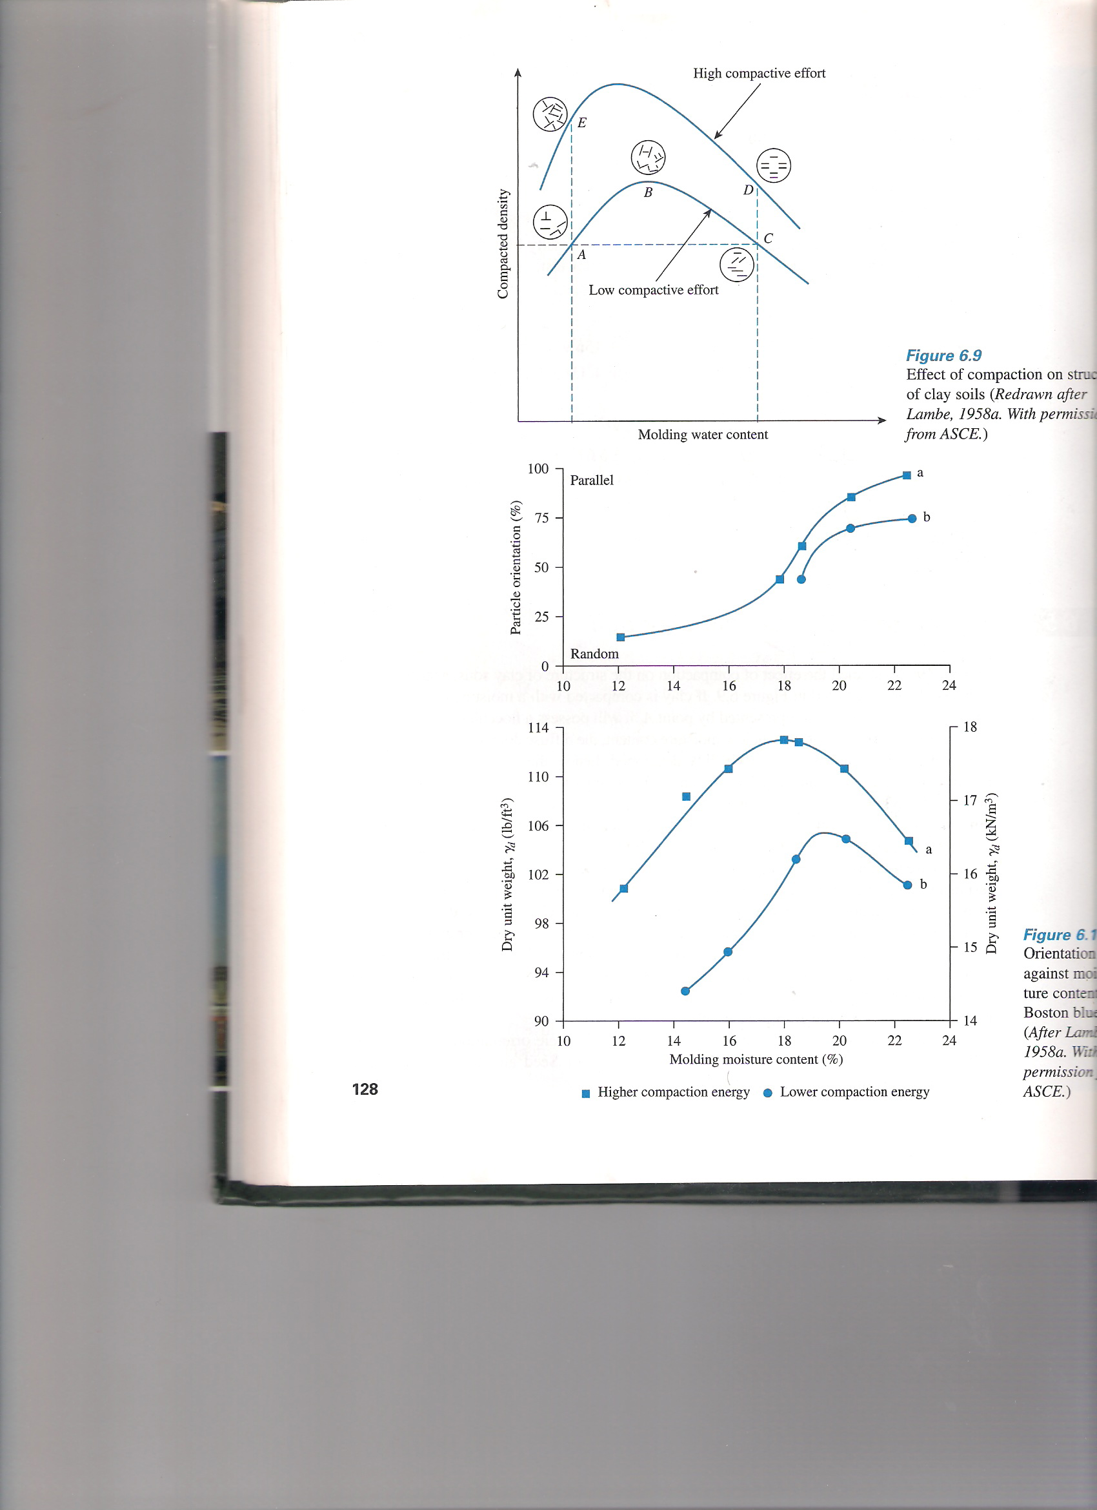
SOIL MECHANICS- KCE3241 SOIL COMPACTION
STRUCTURE OF COMPACTED SOIL

Slide 15
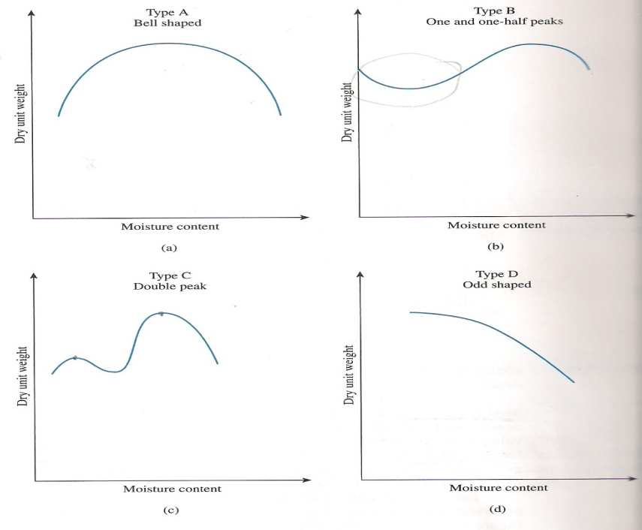
SOIL MECHANICS- KCE3241 SOIL COMPACTION
SHAPES OF COMPACTION CURVE

Slide 16
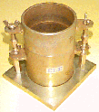

EXPRESSIONS AND CALCULATIONS
SOIL MECHANICS- KCE3241 SOIL COMPACTION
A compacted sample is weighed to determine its mass: M (grams) The volume of the mould is: V (ml) Sub-samples are taken to determine the water content: w
ρd = dry density
ρ = wet density
W = water content

Slide 17
SOIL MECHANICS- KCE3241 SOIL COMPACTION
Ex/ In a typical compaction test the following data might have been collected:
Mass of mould, M_{o} = 1082 g
Volume of mould, V = 950 ml
Specific gravity of soil grains, G_{s} = 2.70
Mass of mould + soil (g) | 2833 | 2979 | 3080 | 3092 | 3064 | 3027
Water content (%) | 8.41 | 10.62 | 12.88 | 14.41 | 16.59 | 18.62

Slide 18

SOIL MECHANICS- KCE3241 SOIL COMPACTION
Calculated Densities and Density Curve
The expressions used are:
Bulk density, ρ (Mg/m³) | 1.84 | 2.00 | 2.10 | 2.12 | 2.09 | 2.05
Water content, w | 0.084 | 0.106 | 0.129 | 0.144 | 0.166 | 0.186
Dry density, ρ_{d} (Mg/m³) | 1.70 | 1.81 | 1.86 | 1.851 | 1.79 | 1.73

Slide 19
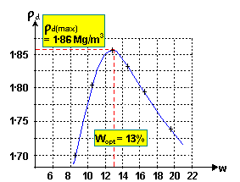
SOIL MECHANICS- KCE3241 SOIL COMPACTION
Ex/ In a typical compaction test

Slide 20

SOIL MECHANICS- KCE3241 SOIL COMPACTION
Air-voids curves
The expression used is: -
Water content (%) | 10 | 12 | 14 | 16 | 18 | 20
ρ_{d} when A_{v} = 0% | 2.13 | 2.04 | 1.96 | 1.89 | 1.82 | 1.75
ρ_{d} when A_{v} = 5% | 2.02 | 1.94 | 1.86 | 1.79 | 1.73 | 1.67
ρ_{d} when A_{v} = 10% | 1.91 | 1.84 | 1.76 | 1.70 | 1.64 | 1.58

Slide 21
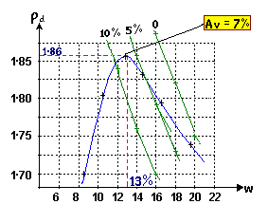
SOIL MECHANICS- KCE3241 SOIL COMPACTION
Air-voids curves
Notes: -
In above figure, it will be seen that the maximum dry density occurs at about (5 %) air void ratio (or about 85 % - 90 % saturation).
At the same point, much of the air remaining in the soil is in the form of small occluded bubbles, entirely surrounded by water, and held in position by surface tension.

Slide 22
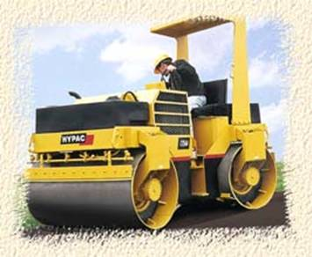
SOIL MECHANICS- KCE3241 SOIL COMPACTION
FIELD COMPCATION
There are three categories of compaction equipments, namely, rollers, rammers, and vibration.
ROLLERS
A. Smooth-wheeled roller
Self-propelled or towed steel rollers ranging from
2 - 20 tones
Suitable for: well-graded sands and gravels silts and clays of low plasticity
Unsuitable for: uniform sands; silty sands; soft clays
B. Grid roller
Towed units with rolls of 30-50 mm bars, with spaces between of 90-100 mm
Masses range from 5-12 tones
Suitable for: well-graded sands; soft rocks; stony soils with fine fractions
Unsuitable for: uniform sands; silty sands; very soft clays

Slide 23
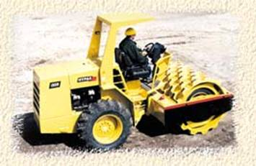

SOIL MECHANICS- KCE3241 SOIL COMPACTION
FIELD COMPCATION
ROLLERS
C. Sheepsfeet roller
Also known as a 'tamping roller'
Self propelled or towed units, with hollow drum fitted with projecting club-shaped 'feet'
Mass range from 5-8 tonnes
Suitable for: fine grained soils; sands and gravels, with >20% fines
Unsuitable for: very coarse soils; uniform gravels
D. Pneumatic-tyred roller
Usually a container on two axles, with rubber-tyred wheels.
Wheels aligned to give a full-width rolled track.
Dead loads are added to give masses of 12-40 tonnes.
Suitable for: most coarse and fine soils.
Unsuitable for: very soft clay; highly variable soils.

Slide 24


SOIL MECHANICS- KCE3241 SOIL COMPACTION
FIELD COMPCATION
Power rammer
Also called a 'trench tamper'
Hand-guided pneumatic tamper
Suitable for: trench back-fill; work in confined areas
Unsuitable for: large volume work
Vibrating plate
Range from hand-guided machines to larger roller combinations
Suitable for: most soils with low to moderate fines content
Unsuitable for: large volume work; wet clayey soils

Slide 25
SOIL MECHANICS- KCE3241 SOIL COMPACTION
FIELD DENSITY TESTS: -
Sand – Cone Method:
Using Ottawa sand passing sieve No. 20 and retained on sieve No. 30.
Core – Cutter method:
Insert a standard cylinder in soil then get it out with soil sample to calculate the density.
Standard Penetration Test (SPT)
Balloon – Density Method

Slide 26

SOIL MECHANICS- KCE3241 SOIL COMPACTION
Hole prepared - plan
Testing with clean dry sand - elevation

Slide 27
SOIL MECHANICS- KCE3241 SOIL COMPACTION
CONTROL OF COMPACTION (Compaction Quality): -The degree of compaction achievable on site depends mainly on:
· Compactive effort: type of plant + No of passes
· Water content: can be increased if dry, but vice-versa
· Type of soil: higher densities with well-graded soils; fine soils have higher water
To check the field density with respect to standard or modified Proctor density, we calculate “Degree of Compaction (D.C.)” or called relative compaction and it is equal to: -
(90 – 95) %

Slide 28
SOIL MECHANICS- KCE3241 SOIL COMPACTION
Compaction and permeability
B
Dry Density
or permeability
C
A
k_{min}
Moisture content

Slide 29
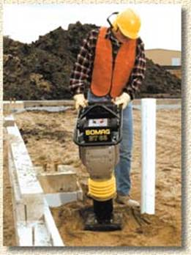
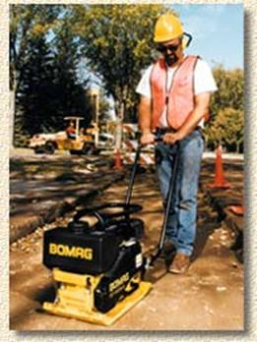
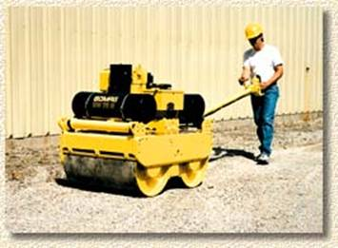
Typical Compaction Equipment
SOIL MECHANICS- KCE3241 SOIL COMPACTION
one person operation

Slide 30
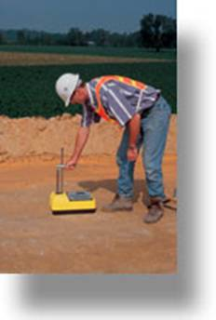
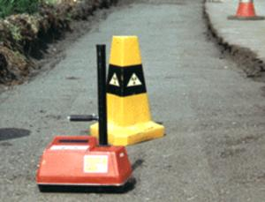
SOIL MECHANICS- KCE3241 SOIL COMPACTION
Nuclear density meter

Slide 31
SOIL MECHANICS- KCE3241 SOIL COMPACTION
Q1: It is decided to use the sand soil of Al Najaf small hill (mount of Al Howaish) in construction of the embankment for the road around the old city. The soil properties of the hill are, total unit weight of 18 kN/m³, water content of 30%, specific gravity of 2.65, and the maximum dry unit weight of 15.07 kN/m³ and optimum moisture content of 32%. The characteristics of the embankment are: degree of compaction of >95%, the embankment was in a trapezoidal shape with dimensions of 16m in the width of the top level, 1m in the height, and the side slope of 2:1. What is the volume in (m³) of the soil from the hill needed to construct the embankment? Find the dry unit weight, saturation, void ratio, porosity for the hill and embankment. What are the effective considerations in the construction of the embankment? Estate the formula used to classify the sand soil according to density. Give the range of the classification. What is the suitable method to examine the coefficient of permeability of the origin soil? Why, derive it.
Length=1000m
Top Level
Height
2
Embankment
1

Slide 32
SOIL MECHANICS- KCE3241 SOIL COMPACTION
Q2: The in-situ moisture content of a soil is 18% and its moist unit weight is 105pcf. The gravity of the soil is 2.75. This soil is to be excavated and transported to a construction site, and then compacted to a minimum dry weight of 103.5pcf at a moisture content of 20%:
How many cubic yards of excavated soil are needed to produce 10000 yd³ of compacted fill?
How many trucks are needed to transport the excavated soil, if each truck can carry 20 ton?
Q3: a contractor has compacted the base course for a new and found that the average values of test samples show the water content of 14.6%, specific gravity of 2.81, and the unit weight of 18.2 kN/m³. Knowing that the specifications require that the void ratio ≤ 0.80, has the contractor complied with the specifications?

